Slide 1

Team 3 «Lucky Seven»

Slide 2
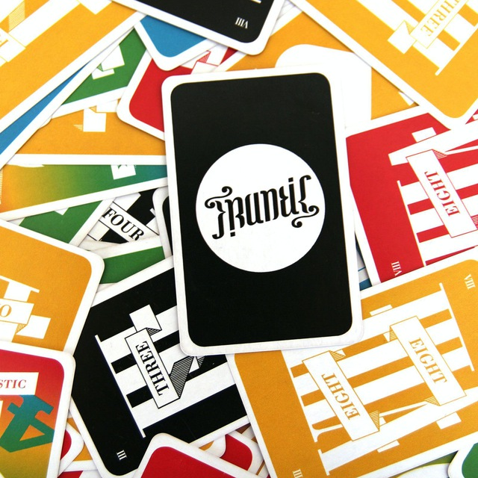
Content
Introduction
What is Frantic?
Why our Project?
Functionalities
Beta Presentation
Future Functionalities
Steam
Summary

Slide 3
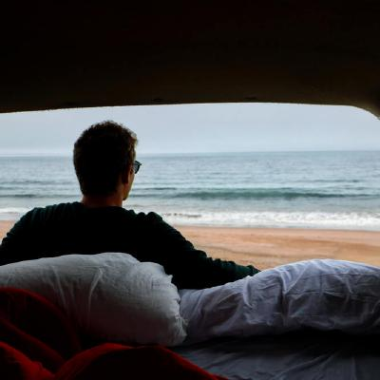
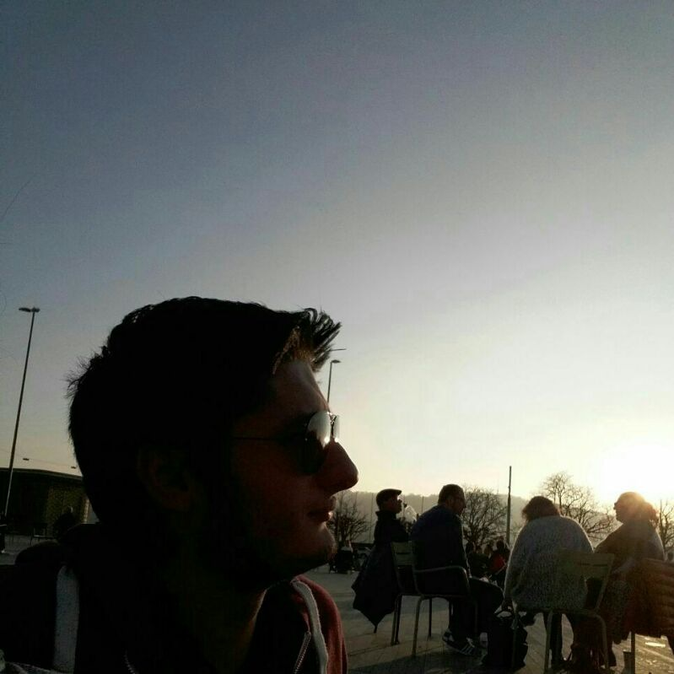
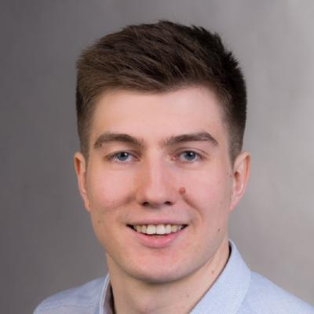
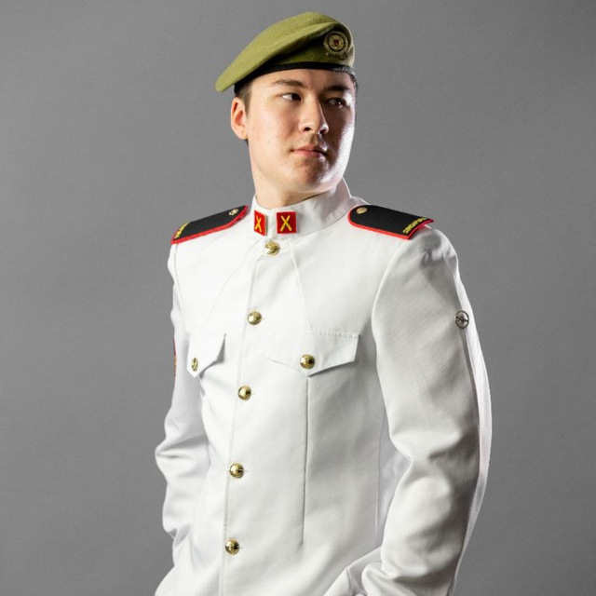
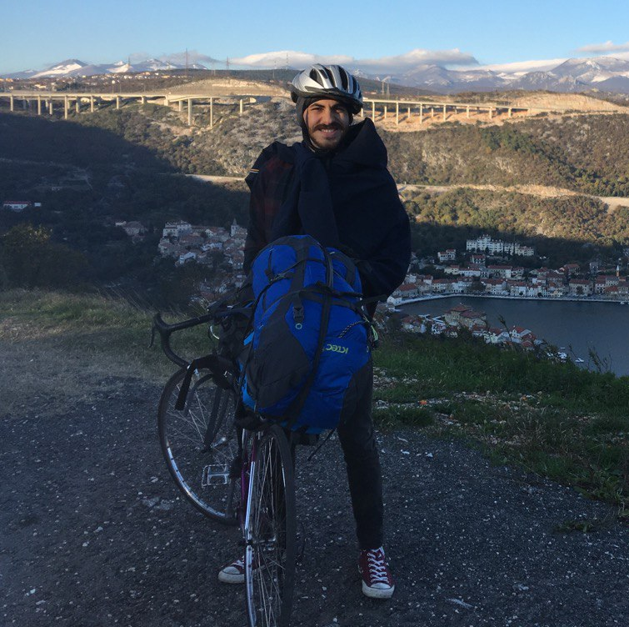
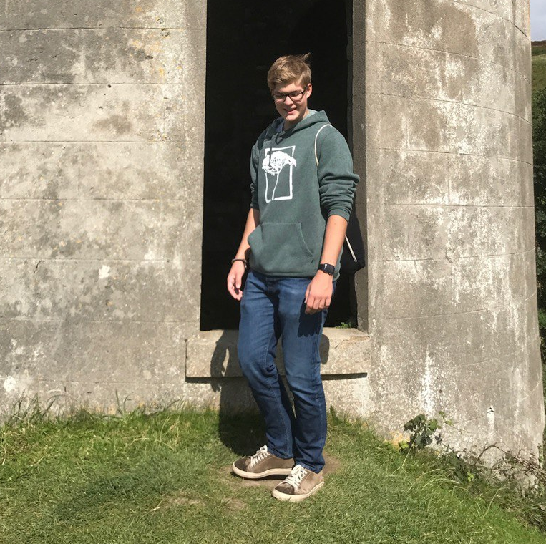
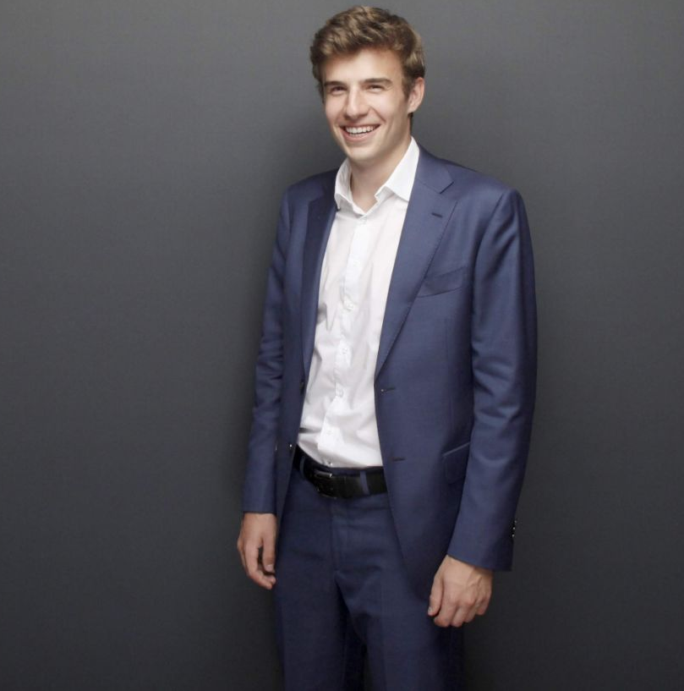
Samuel Stalder
Erman Zankov
Nikita Smailov
Lukas Zoss
Gökhan Bag
Tobias Ritscher
Joel Plambeck

Slide 4

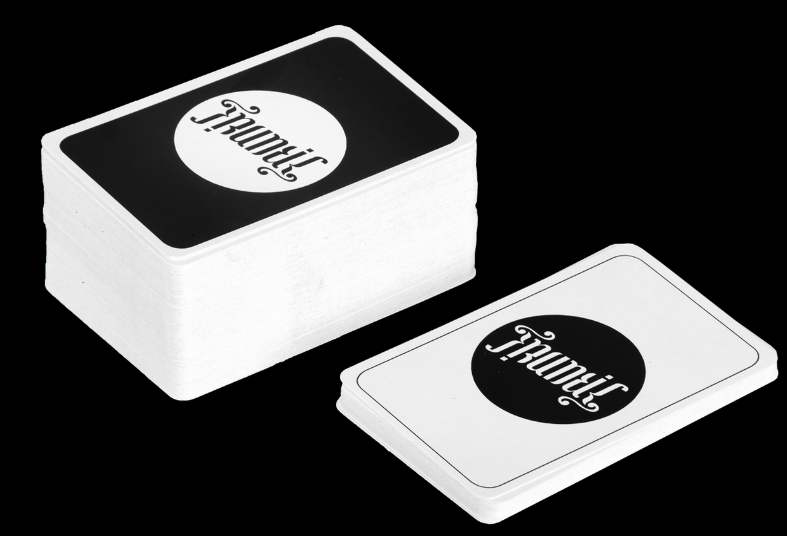


What is Frantic?

Slide 5
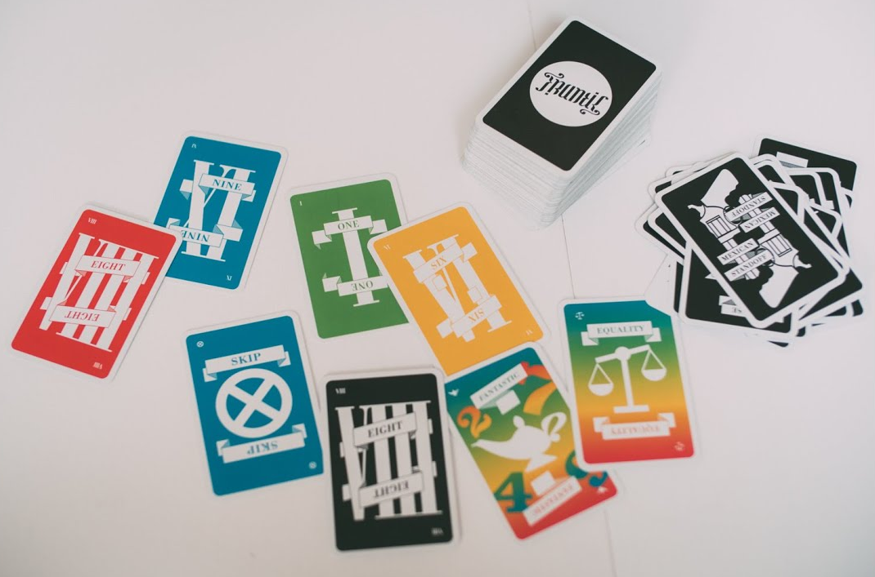
What is Frantic?

Slide 6

Why our Project?
2020

Slide 7


Why our Project?
2020

Slide 8
Why our Project?
BUT …

Slide 9
Why our Project?
2020
Very bad, would not recommend.

Slide 10













COVID
2020

Slide 11

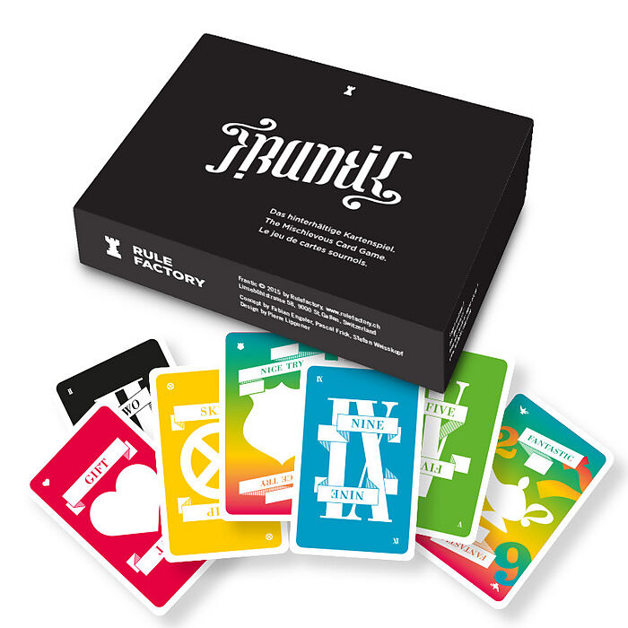


Slide 12
Why our Project?
FRANTIC
NOW

Slide 13

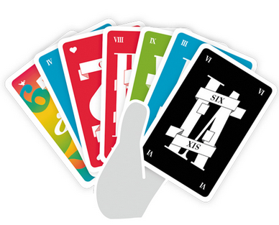

Slide 14

Functionalities

Slide 15

Functionalities

Slide 16

Functionalities

Slide 17

Functionalities

Slide 18


Slide 19
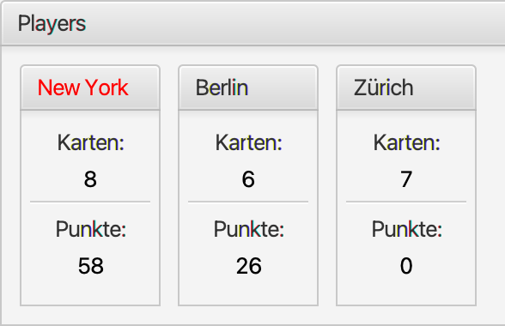
Play over the Internet
Future Functionalities

Slide 20
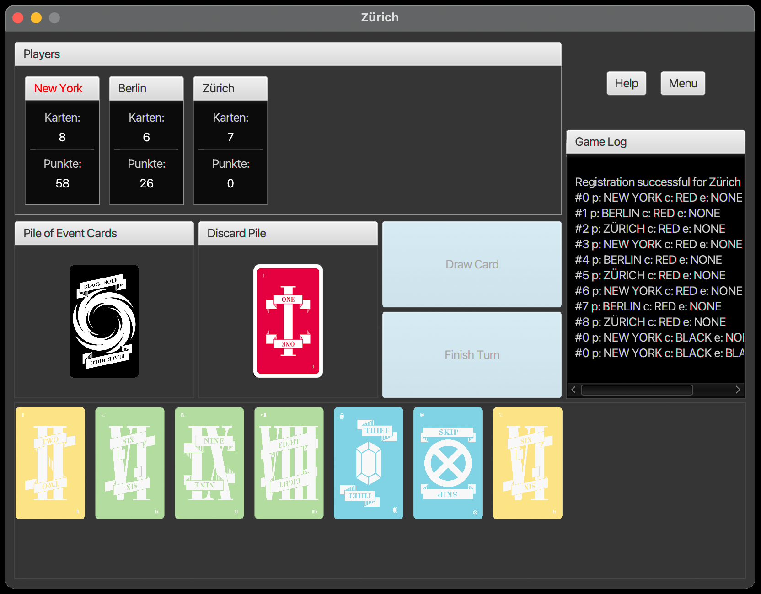
Future Functionalities

Slide 21
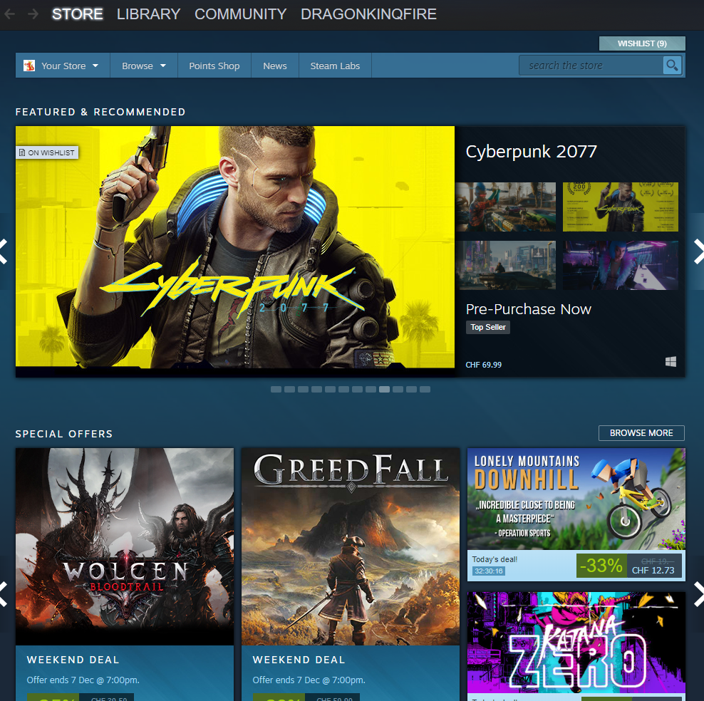



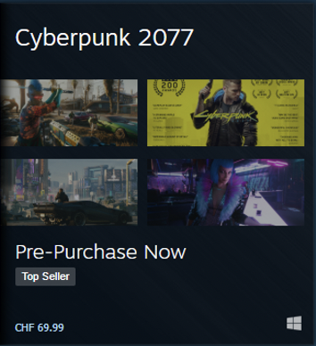
Steam
15.- CHF
Some other unimportant games

Slide 22
Summary

Slide 23
One More Thing…

Slide 24


